Slide 1
The for loop

Slide 2
Repetition with for loops
So far, repeating a statement is redundant:
  System.out.println("Homer says:");
  System.out.println("I am so smart");
  System.out.println("I am so smart");
  System.out.println("I am so smart");
  System.out.println("I am so smart");
  System.out.println("S-M-R-T... I mean S-M-A-R-T");
Java's for loop statement performs a task many times.
  System.out.println("Homer says:");
  for (int i = 1; i <= 4; i++) { // repeat 4 times
  System.out.println("I am so smart");
  }
  System.out.println("S-M-R-T... I mean S-M-A-R-T");
Notes:
also related to book exercise 1.10 about printing 1000 copies of "All work and no play makes Jack a dull boy"

Slide 3
for loop syntax
  for (initialization; test; update) {
  statement;
  statement;
  ...
  statement;
  }
  Perform initialization once.
  Repeat the following:
    Check if the test is true. If not, stop.
    Execute the statements.
    Perform the update.
header
body

Slide 4
Initialization
  for (int i = 1; i <= 6; i++) {
  System.out.println("I am so smart");
  }
Tells Java what variable to use in the loop
  Performed once as the loop begins
  The variable is called a loop counter
    can use any name, not just i
    can start at any value, not just 1

Slide 5
Test
  for (int i = 1; i <= 6; i++) {
  System.out.println("I am so smart");
  }
Tests the loop counter variable against a limit
  Uses comparison operators:
  < less than
  <= less than or equal to
  > greater than
  >= greater than or equal to

Slide 6
Increment and decrement
shortcuts to increase or decrease a variable's value by 1
  Shorthand Equivalent longer version
  variable++; variable = variable + 1;
  variable--; variable = variable - 1;
  int x = 2;
  x++; // x = x + 1;
  // x now stores 3
  double gpa = 2.5;
  gpa--; // gpa = gpa - 1;
  // gpa now stores 1.5

Slide 7
Modify-and-assign
shortcuts to modify a variable's value
  Shorthand Equivalent longer version
  variable += value; variable = variable + value;
  variable -= value; variable = variable - value;
  variable *= value; variable = variable * value;
  variable /= value; variable = variable / value;
  variable %= value; variable = variable % value;
  x += 3; // x = x + 3;
  gpa -= 0.5; // gpa = gpa - 0.5;
  number *= 2; // number = number * 2;

Slide 8
Repetition over a range
  System.out.println("1 squared = " + 1 * 1);
  System.out.println("2 squared = " + 2 * 2);
  System.out.println("3 squared = " + 3 * 3);
  System.out.println("4 squared = " + 4 * 4);
  System.out.println("5 squared = " + 5 * 5);
  System.out.println("6 squared = " + 6 * 6);
  Intuition: "I want to print a line for each number from 1 to 6"
The for loop does exactly that!
  for (int i = 1; i <= 6; i++) {
  System.out.println(i + " squared = " + (i * i));
  }
  "For each integer i from 1 through 6, print ..."

Slide 9
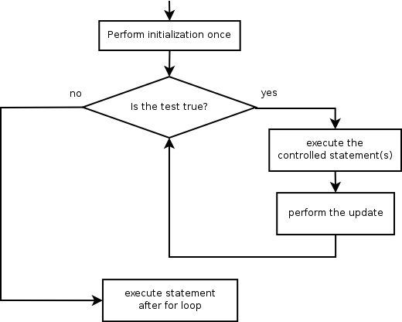
Loop walkthrough
1
2
3
  for (int i = 1; i <= 4; i++) {
  System.out.println(i + " squared = " + (i * i));
  }
  System.out.println("Whoo!");
Output:
1 squared = 1
2 squared = 4
3 squared = 9
4 squared = 16
Whoo!
4
5
1
2
4
3
5

Slide 10
Multi-line loop body
  System.out.println("+----+");
  for (int i = 1; i <= 3; i++) {
  System.out.println("\\ /");
  System.out.println("/ \\");
  }
  System.out.println("+----+");
  Output:
  +----+
  \ /
  / \
  \ /
  / \
  \ /
  / \
  +----+

Slide 11
Expressions for counter
  int highTemp = 5;
  for (int i = -3; i <= highTemp / 2; i++) {
  System.out.println(i * 1.8 + 32);
  }
  Output:
  26.6
  28.4
  30.2
  32.0
  33.8
  35.6

Slide 12
System.out.print
Prints without moving to a new line
  allows you to print partial messages on the same line
  int highestTemp = 5;
  for (int i = -3; i <= highestTemp / 2; i++) {
  System.out.print((i * 1.8 + 32) + " ");
  }
  Output:
  26.6 28.4 30.2 32.0 33.8 35.6
    Concatenate " " to separate the numbers

Slide 13
Counting down
The update can use -- to make the loop count down.
  The test must say > instead of <
  System.out.print("T-minus ");
  for (int i = 10; i >= 1; i--) {
  System.out.print(i + ", ");
  }
  System.out.println("blastoff!");
  System.out.println("The end.");
  Output:
  T-minus 10, 9, 8, 7, 6, 5, 4, 3, 2, 1, blastoff!
  The end.

